Slide 1
Data Science Platform – RoadMap
Last Updated : 21/04/2020

Slide 2
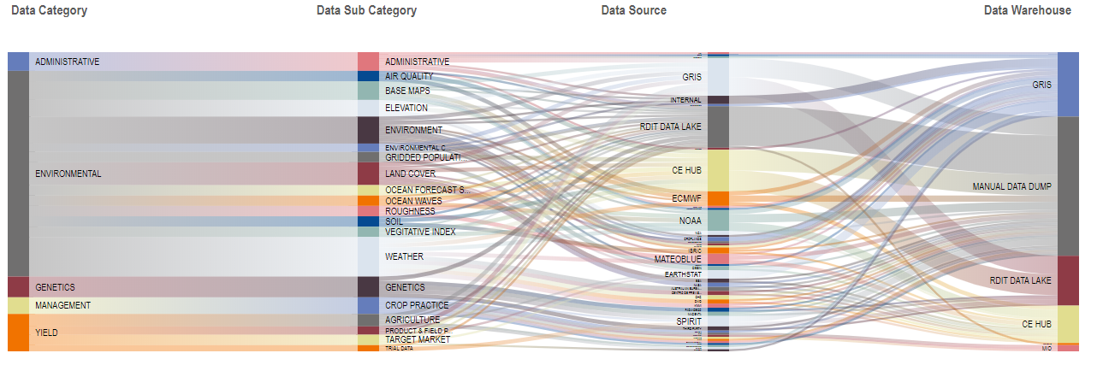
Reality of our today
Majority of front-end tools supported via manual data management processes

Slide 3
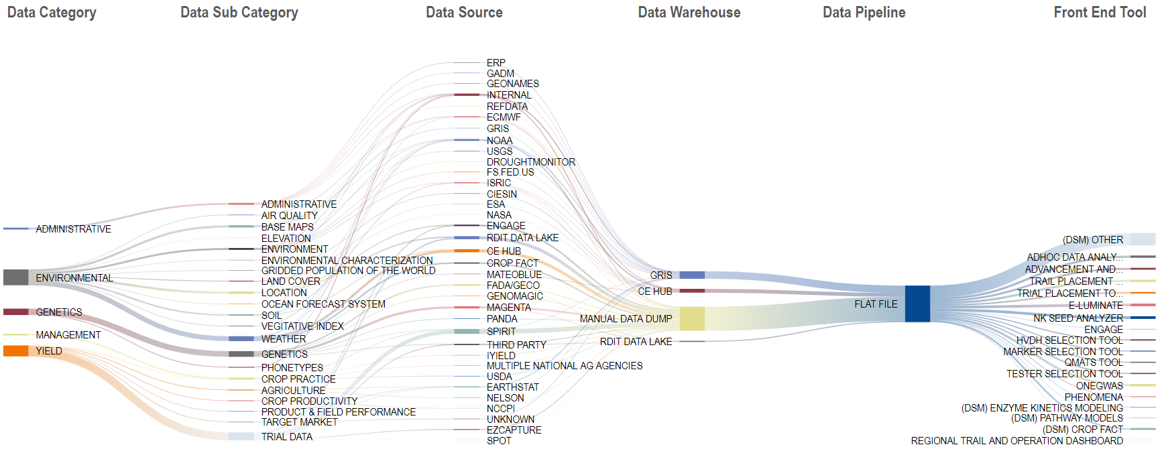
Opportunity | Establish a Data Science Sandbox
Data Scientists | Reduce time Data Scientists spend as Data Engineers
Challenges
Data Scientists are using their own machines to build analytical models with limited computation power.
Desktops are used to train and test analytical models which is quite time consuming and limiting (data sets)
Analytical models are, at times, deployed on personal machines, greatly reducing the performance
Visibility into complete list of analytical models is limited, reducing the ability to repurpose and reuse.
Recommendation
Integrated data science sandbox
Common place for deployment. Data Scientists should have access to other scientists’ data and data models for reuse
Strong computational power to support training and testing of complex analytical models with very large data sets

Slide 4
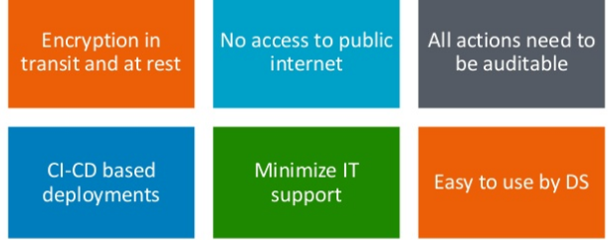
Business Requirements
Interview with Data Scientists across the functions
Enable Notebook with all the Packages , Ability to use Zoo/diverse set of eco system frameworks/interfaces for deep learning and machine learning
Metadata for Analytical data mart access ,Either by integration with existing catalog’s or an ability to catalog.
Multitenant data science platform
Hosting and training of their solutions with an ability to use infra of their choice over cloud
Access to other AWS services which help with machine learning capability
Cl/CD framework to ensure a good steady state
Deployment as microservice/s
Information and security platform needs
should not be exposed to internet
Data should be secured and stored as per compliance requirements
User actions in the environment need to be regulated and auditable
Ability to define ROLE’s
Communication need to be over secured channel(TLS), Hence firewall need to be configured accordingly
Key Requirements

Slide 5
Opportunity | Establish a Data Science Sandbox
Data Scientists | Reduce time Data Scientists spend as Data Engineers
Address this challenge with POC of Data Science Platform to select DS within R&D Seeds
Challenges
Data Scientists are using their own machines to build analytical models with limited computation power.
Desktops are used to train and test analytical models which is quite time consuming and limiting (data sets)
Analytical models are, at times, deployed on personal machines, greatly reducing the performance
Visibility into complete list of analytical models is limited, reducing the ability to repurpose and reuse.
Recommendation
Integrated data science sandbox
Common place for deployment. Data Scientists should have access to other scientists’ data and data models for reuse
Strong computational power to support training and testing of complex analytical models with very large data sets

Slide 6
Transition
FROM
TO
Adhoc setup and management of Notebook
Easy exploration in AWS notebooks
Limited and ungoverned choices of model deployment
Building around virtualization and flexibility
Competing computing resources across teams
Auto scalable model training and serving environment
Time consuming provisioning(infra)
Automated DEV-SEC- OPS practices
Lack of stage transition and reproducibility
Automated CI/CD practices
Lack of collaboration among data scientist
Knowledge repository and sharing of best practices

Slide 7
Roadmap
30 Users
100 Users
100+ Users
Q2- MVP with SageMaker
Q3 – Stabilize
Q4 – Ease to the users
Minimal set up for Data exploration
Distributed training that works with you
ML Flow Model Tracking
Model Repository Enablement
New Services in AWS
CI/CD
Alert Generation
UI/UX for Ease of use
TBD
Available Algos for big data
Easy to Deploy solution
Compute capability on Demand
Model Management
Security and Scalability
Lifecyle and Pipeline
Automate user Onboarding
Wrapper Services
TBD
Training and Demonstration
IT Collaboration Key Asks (CE, CF and Info Sec teams)
Achieve Reliability, Availability (High Availability-HA) and Scalability (RAS): e.g. Scaling up components over ECS or OpenShift. MUST (AWS)
Speed to user on boarding e.g. IAM , Cognito , OKTA . NICE TO HAVE (AWS)
Serviceability , ease at which system can be maintained and repaired : E.g. ELK , Alerting mechanism(SNS) , Storage Lifecycle , Canary Deployment capability. NICE TO HAVE (AWS)
Increased number of published models where production schedule adherence had no issues e.g. , Integration of Gitlab ,mlflow, Airflow, AWS Services. MUST (AWS)
Solution Architect
Operation support
Solution Architect
Operation support
Solution Architect
Operation support
X2
X2
X3

Slide 8
R&D Seeds onboarding timeline
On board first few data scientists( All those Interested in Model Training and/or Serving)
Continuous training sessions arranged with respect to platform as well as technologies
Help with use case on-boarding ,By helping with respect to development of pipeline and Code transition
What’s new sessions after each release/feature

Slide 9
Journey so far
Data Scientist (DS) using Desktop
DS using Cazena Platform
DS Using ICL
DS Using DataSciece Platform
DS Using Data Science Platform + Sagemaker
June 2018
Nov 18 – June 2019
June 2019 – Aug 2019
Aug 2019
Vision for Aug 2020
More time experiment
Unable to do other tasks
Not motivated to do complex tasks
Prone to fail more often
Cannot test new services
Data on local PC
Ability to use cloud computing
Able to run task on server
Can easily used new cloud services
Data cannot be transfer on Cazena S3
Ability to use computing
Able to run task on server
Can easily install new services/Packages/tools
Data need to be transfer
Hard to find what failed
Tool versioning
Pip installation
AWS Cloud compute
Connected to Smart Mart
Not able to scale
Cannot run many high compute tasks
Very Adhoc
Container oriented
Hosting as a service
Notebook as a services
Sagemaker Algorithm
Ease of deployment
Playground for Data scientist
Crate a platform which enable data scientist to focus on only data Science
We need strong collaboration with Data scientist, Information security, cloud enablement and cloud factory team

Slide 10
Road map for 2020
Q1
Q2
Q3
Q4
2021
Comments
Quarterly
Single view app to serve all components and enable charge back model.
Formalize Onboarding Process
Deploy data science use cases
Design thinking based approach – improvement of architecture based on feedbacks and on boarding
UI/UX Improvements
Orchestration Services
Evolution and Enablement
A/B Testing
What's new in the release milestone videos and webinars
Webinar to the Community
Model Management
Model Management
Ability to scale with respect to compute and storage
E2E pipeline creation made easy
Repository/Management
Training and Serving
Lifecycle and Pipelines
Standardize efficient releases on a much more frequent basis
Monitor w.r.t Platform and Data Science
Security Ground Up ( SSO , Encryption , Network etc.,)
OPS
Management
CI- CD
Alerting and Monitoring
Scalability and Security Releases
Strategic
Security / Threat
Automated service catalog
Training Assessment & 2021 Planning
IT Sponsored Training Programs
Business Funded Training Programs
Quarterly Expert Speaker
Annual Analytics Summit
Technical Blogs
TRAINING
Community Launch
Expert Speaker
User Guides/Help Site Launch
Analytics Summit
Mentorship Program
DATA
COMMUNITY
Monthly Meet-ups
Quarterly F2F office hours event
Quarterly Hack-a-thons
Development of User guide
Meetups
Hack-a-thons
User Guides
Hackathon Launch
Slack Channels
Pilot Phase
Soft Launch
Full Launch
TBD

Slide 11
FAQ
How do we on- board user ?
How to port current user code ?
Yes we can bring own Algorithm
Does Sage maker Work with R ?
SageMaker (with the help of ‘reticulate’ python package)
Apart from training and deployment , Can we also do EDA , development ?
Yes with the interactive notebook (As of now we have a Jupyter hub which can talk to SageMaker Training and Deployment , Other ML services)
Can I integrate with other environments ?
Yes per say from user desktop IDE(PyCharm , Spyder ).
How are we going to orchestrate the entire pipeline ?
We can use AWS Step + Lambda , Airflow
Does it integrate with internal code and package repository
Yes with Gitlab
By the way, we are fine tuning AWS security groups , network and certificates configured for a successful handshake
If at all for certain use cases require other ML services of AWS ,we can however, we might need to request for a firewall port opened for a TLS communication
Currently with the help of JIRA ticket: user requests access to sandbox , What Next?
How do we manage lifecycle and pipelines?
Minimum viable Orchestration and Model Management services are available
Platform team creates user id and password, which would help user to access Jupyter Notebook(Hub) and RStudio
Also configure environment variables so that user can install libraries from internal repositories
Create a Cloud Enablement JIRA ticket for S3 and SageMaker access
Onboarding training for users every month ( Video recording session for future user– after first 5 trainings)
Currently we do not separate users who can execute code on GPU or CPU
Which are not authenticated and authorized
Need to go thru transition code changes
AWS managed Notebook service , Need to be enabled

Slide 12
Appendix

Slide 13
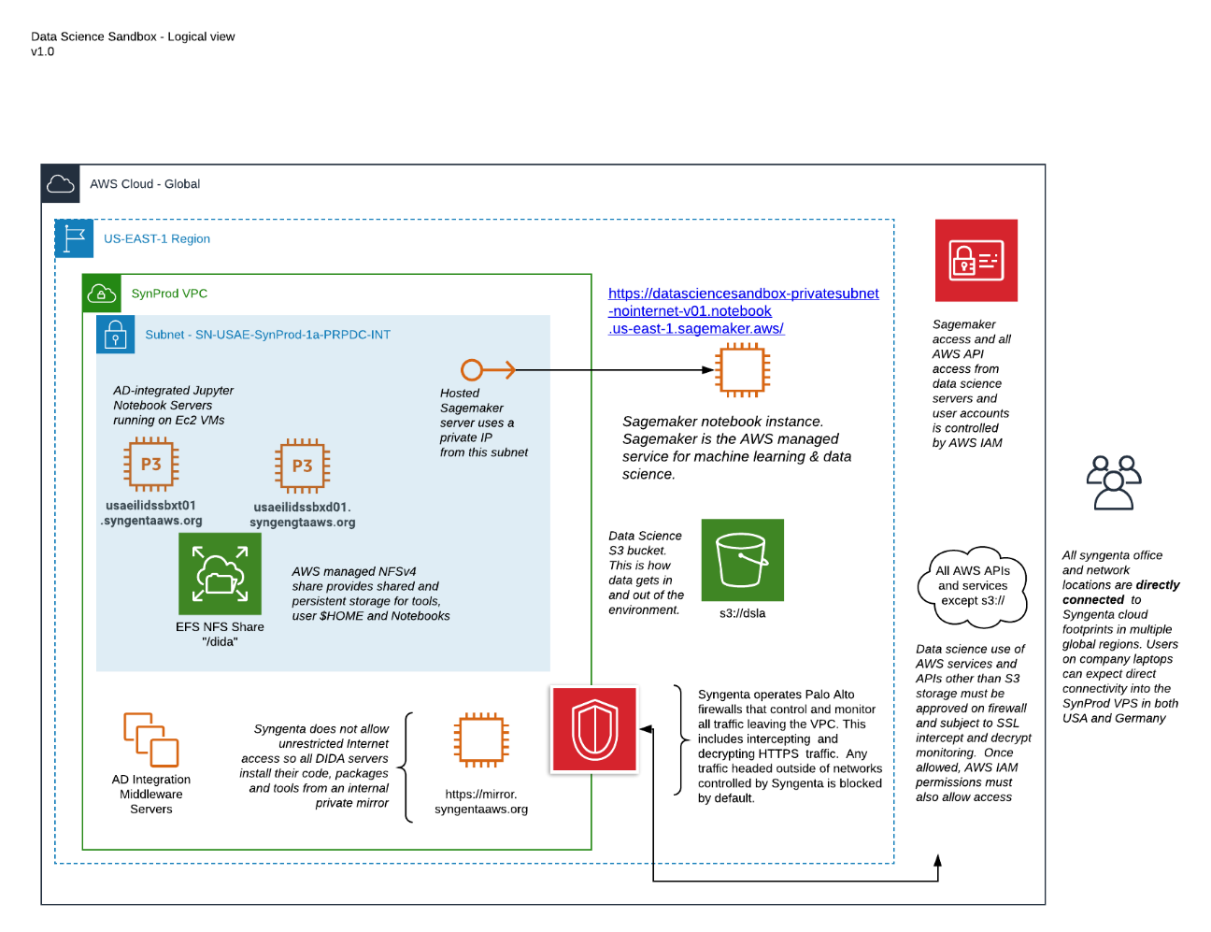
Current Architecture
User are able to use cloud compute
Able to work on notebook
Pip install for most updates and packages
Connect with internal data lakes
Bring their own data on s3
32 CPU and 5 GPU

Slide 14
Benefits of using machine learning in cloud
Size of dataset
Clustered training
Hyper parameter tuning
Training / Serving Skew : Difference between performance during training and performance during serving
De-coupling model from client
Auto scaling prediction

Slide 15
Why?
AWS Sagemaker

Slide 16
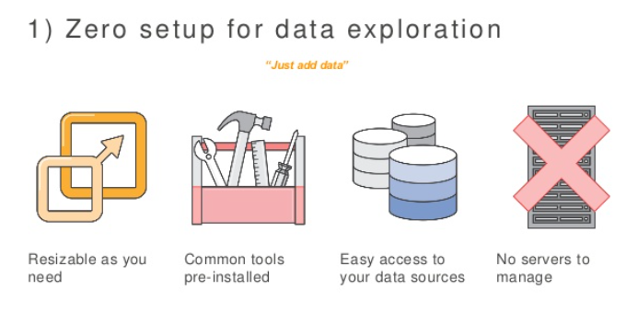
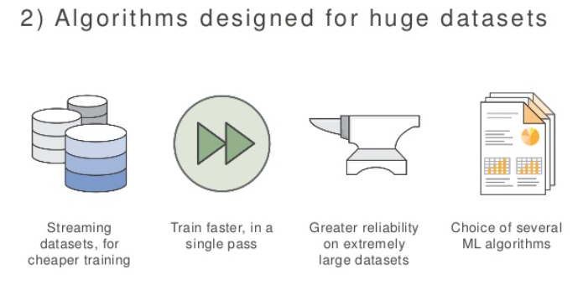
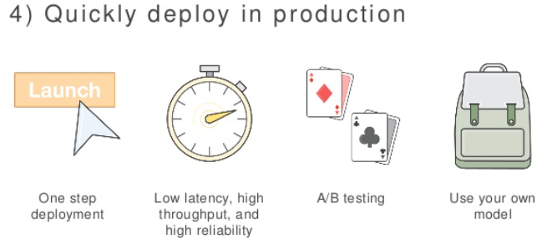
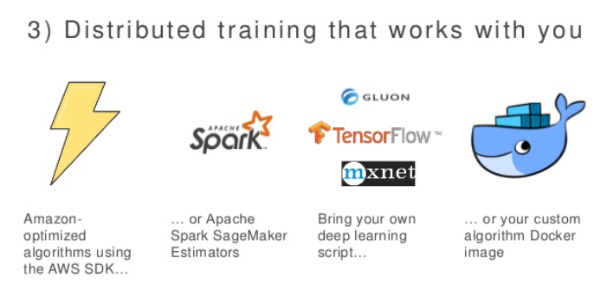
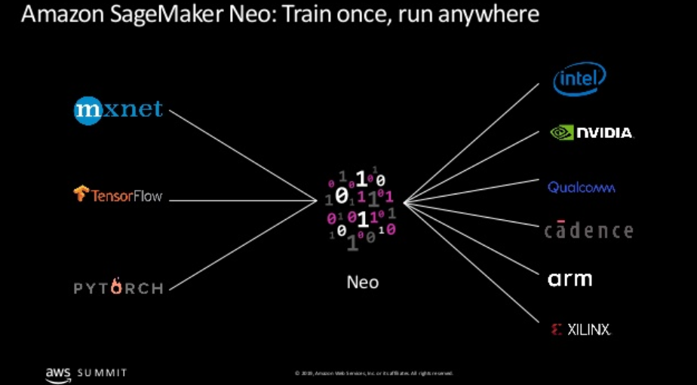

Slide 17
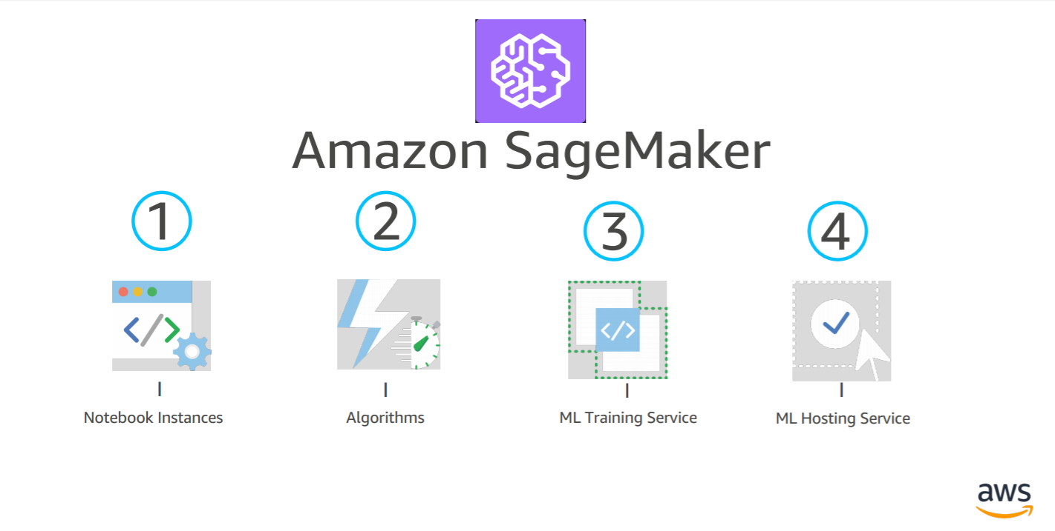
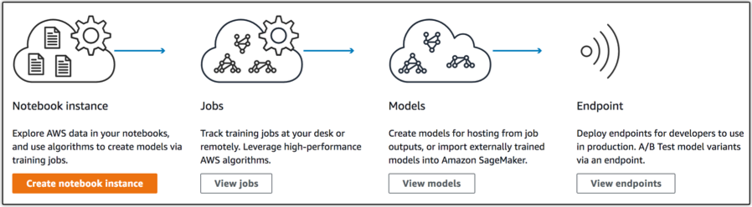
Services
A fully managed service that enables data scientists and developers to quickly and easily build machine-learning based models into production smart applications

Slide 18
Evolving Architecture : Future Plans
Enable highly regulated sagemaker access that would help in
Notebook access
Back charge the consumers requesting for the access
Other ML use cases
SageMaker Neo : new deep learning model compiler lets customers train models once, and run them anywhere
Amazon Textract : uses machine learning to instantly read virtually any type of document to accurately extract text and data without the need for any manual review or custom code
Computer Vision : can gain high-level understanding from digital images or videos
Ground Truth : offers easy access to labelers through Amazon Mechanical Turk and provides them with built-in workflows and interfaces for common labeling tasks.

Slide 19
Behind the Scenes
How does it work

Slide 20
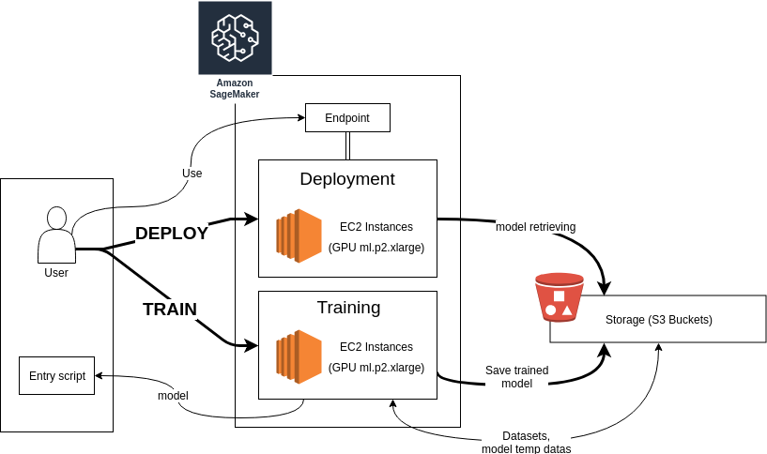
Life Cycle

Slide 21
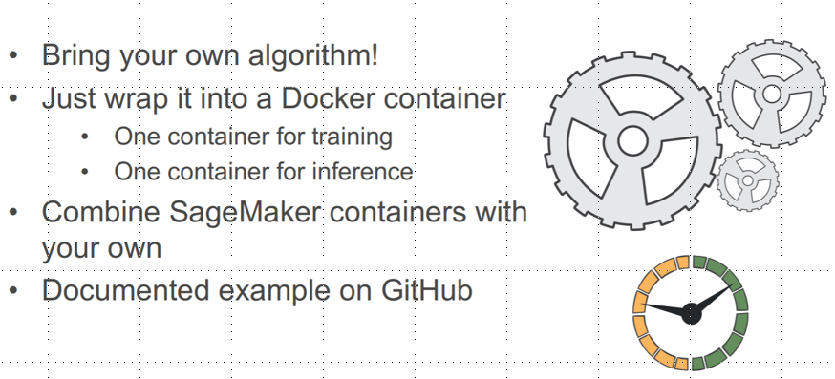
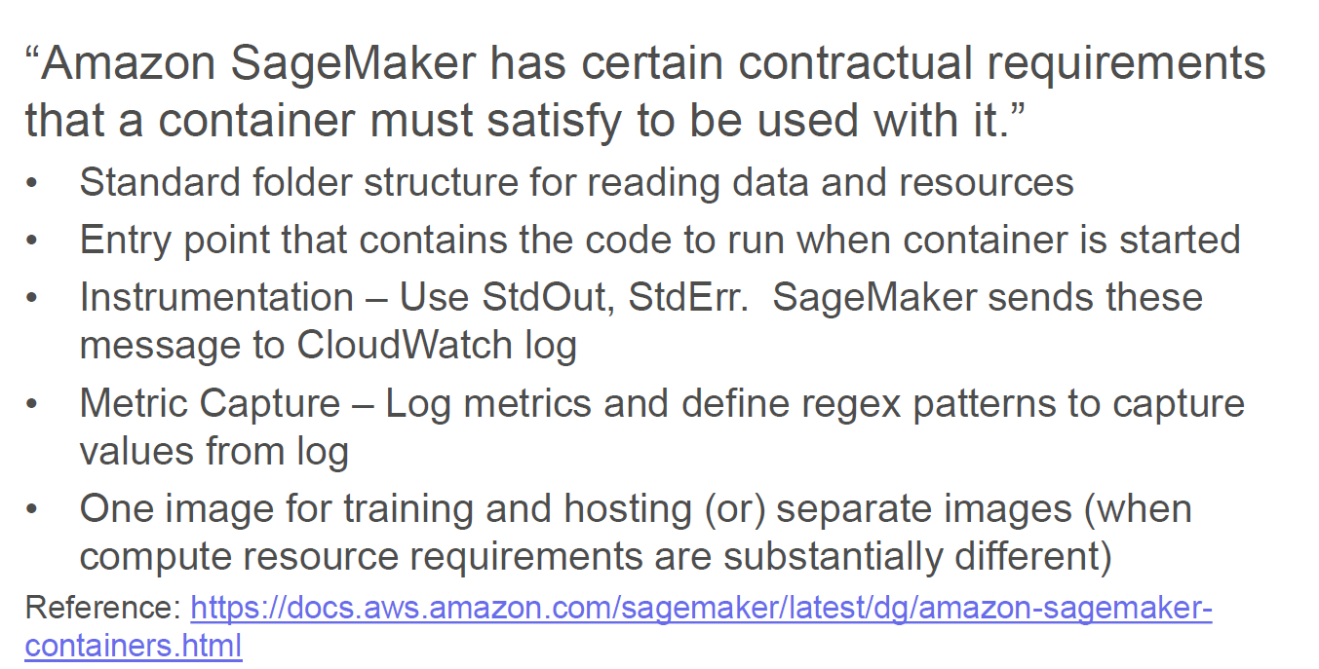
Bring Your Own Algorithm

Slide 22
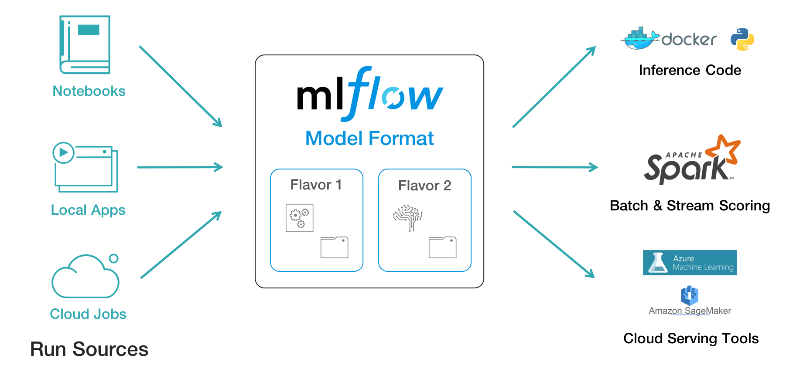
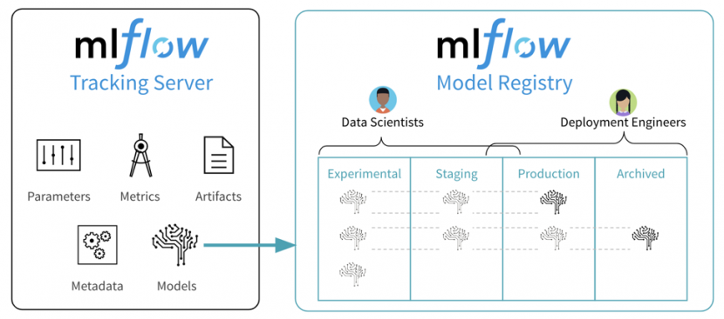
Cloud Agonistic ? : ML Flow and Sage maker

Slide 23
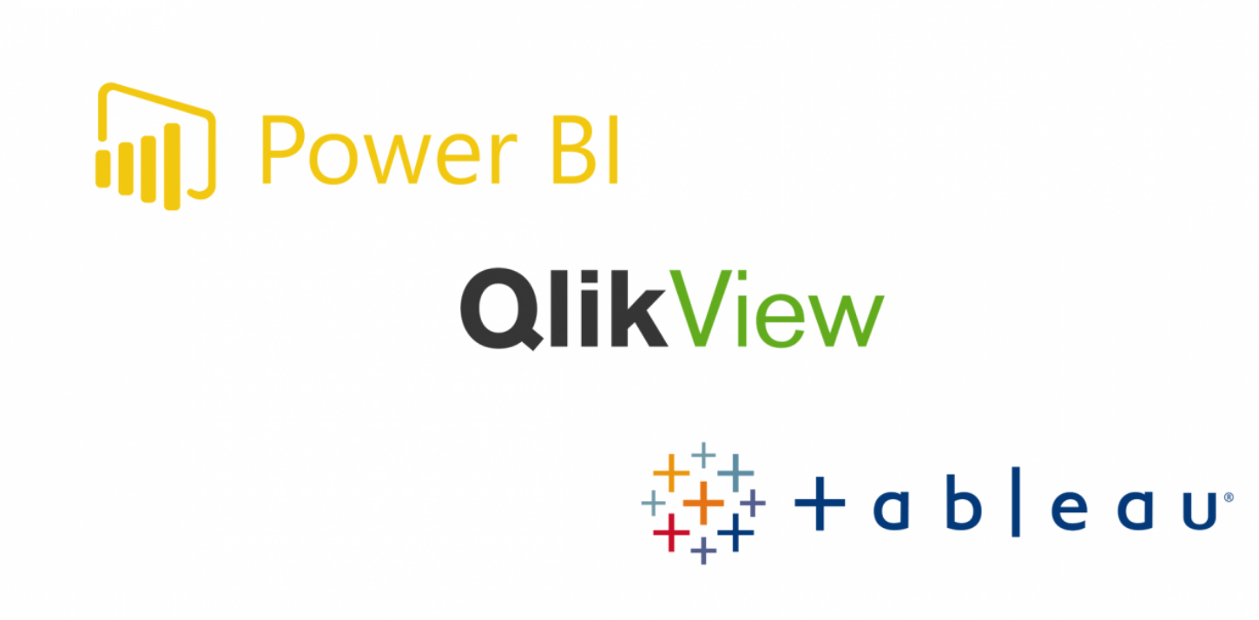




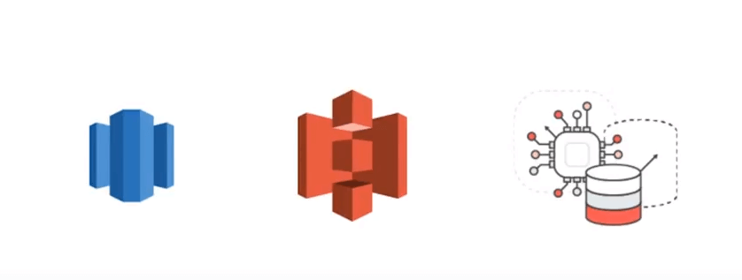
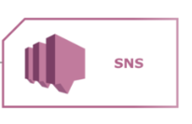
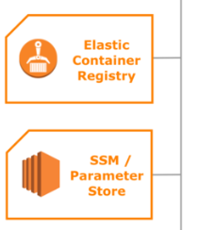
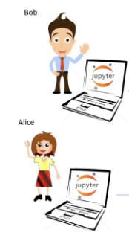




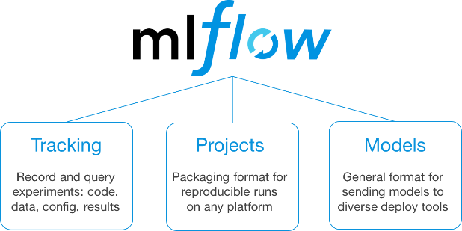

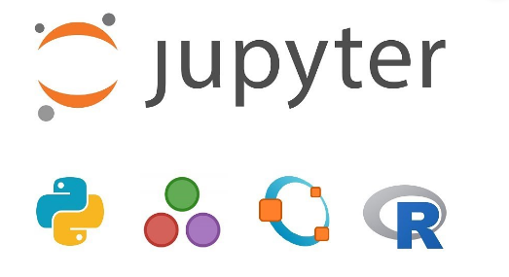
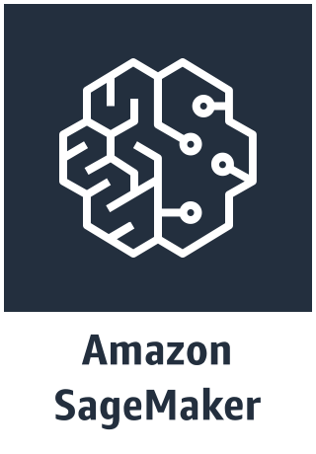

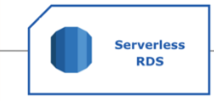
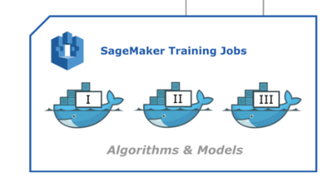

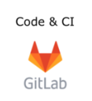
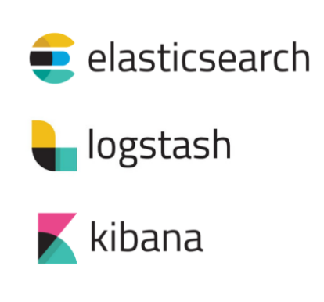




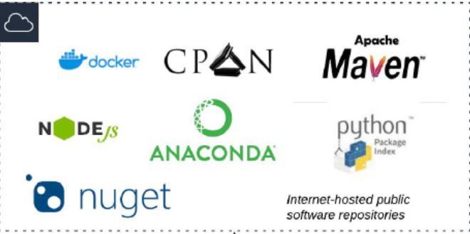
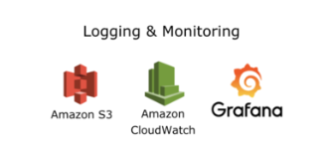
Vision
Data Warehouse
Manage Entire PAAS Collaborate with Cloud Team for IAAS
Data Lake
Data Streams
Scheduling Heterogeneous Parameterized / Notebook Pipelines
Model Repository
Testing complete
Partial testing complete
Testing not done at all

Slide 24
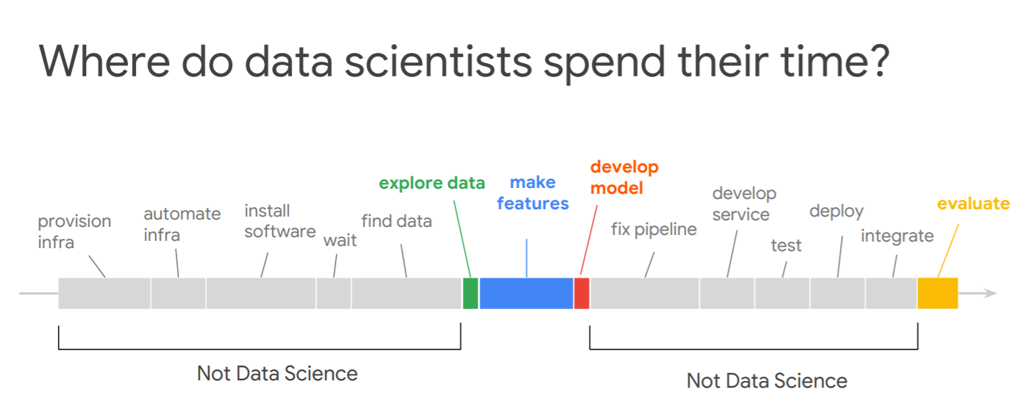

Slide 25


Thank You !

